Slide 1
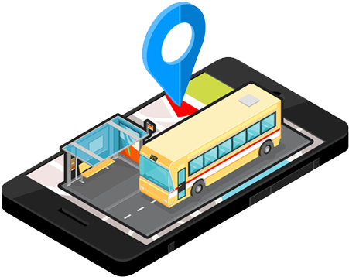
Advanced Object Oriented Programming
KLH Bus Tracking Application

Slide 2
TEAM MEMBERS
2110030323-Rama Kowshik
2110030291-Shaik Farhaan Ali
2110030295-Venkata Suhas

Slide 3
Introduction
“KLH Bus Tracking Application” is an application for Smart phones that works on Android Operating system.
This application uses the GPS function.
This application uses a variety of technologies to track the locations of buses in real time.

Slide 4
Problem Faced
In the daily operation of bus transport systems, mainly that of buses, the movement of vehicles is affected by different uncertain conditions as the day progresses, such as :
traffic congestion
unexpected delays
Irregular vehicle-dispatching times
other incidents.
Many students are late for classes because they decide to wait for the bus instead of just simply using a alternate transportation.

Slide 5
Solution through our application
1
2
It provides Real-time bus location information so that they may not get delayed.
3
Integrated Google Maps in the application.
Focus on to providing them more convenience with bus schedules.

Slide 6
Development Environment
The proposed system requires Android Studio that is an open source software development environment.
Eclipse consists of an Extensible plugin system and an IDE.
The Android project has been developed in the Android Studio 4.0, as it has plugins that are mainly used for Android.

Slide 7
ANDROID SDK
Integrated Development Environment (IDE) is used in Android development in order to make it more straight forward and quick.
It has been recommended for the developers because of its simplicity in working.
Android is basically a multitasking platform.
These applications can work simultaneously with other applications because of multitasking ability of the Android platform.

Slide 8


Software used for making application
Android Studio
Fire Base

Slide 9
Project Modules
Location Information
Map
Bus/Route Information

Slide 10
Module 1- Location Info
This module depicts the process of selection of Bus no and presenting the current location of the Bus.
TECHNOLOGY APPLIED:
GPS – Global Positioning System.
Client-Server Technology.

Slide 11
GPS- Global Positioning System
It is a technology where satellites send down radio signals which GPS units and receivers use to work out their current location (which is shown by latitude, longitude and elevation).
GPS works like this:
There are 24 working satellites circling the globe at any given moment. A GPS navigator or GPS tracker searches for the transmission signal from at least three satellites

Slide 12
Client- Server Working
1
Client will ask for the location of the bus through his android device. Request to the Server is made automatically.
2
Bus is equipped with GPS device.
3
Server will handle the locations and deliver it to the intended client.
Through GPS it will find its location and deliver it to Server.

Slide 13
Data Flow Diagram
Requset Location
System
Send location
User
Server
Send Location
Request Location
DataBase

Slide 14
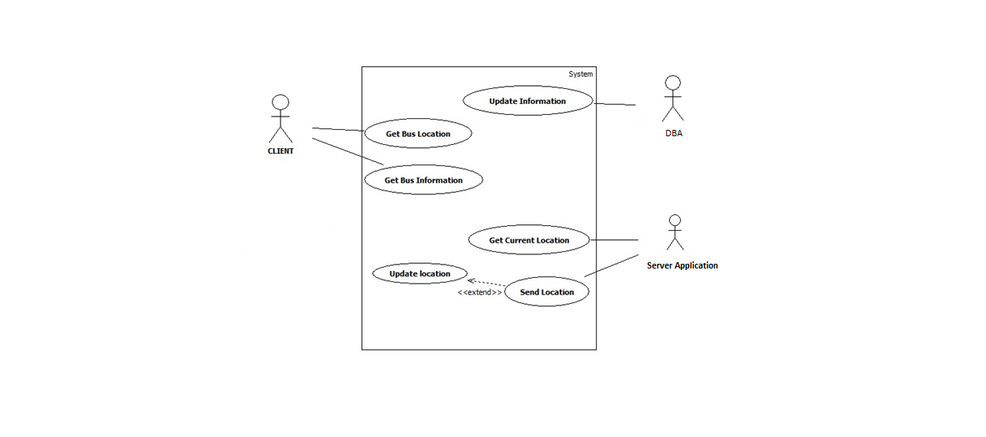
Use Case Diagram :

Slide 15
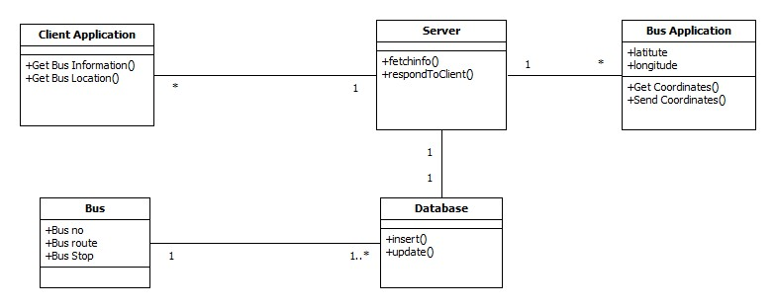
Class Diagram :

Slide 16
Applications
Commonly used by fleet operators for fleet management functions such as fleet tracking, routing, dispatch, on-board information and security.
Popular in consumer vehicles as a theft prevention and retrieval device.
Asset tracking: Companies needing to track valuable assets for insurance.

Slide 17
Advantages
Reduces traffic in clumsy areas.
Makes people to avoid unexpected delays.
Improves scheduling of vehicle timings.
Disadvantages
GPS based location system may not work properly during inappropriate weather conditions.

Slide 18
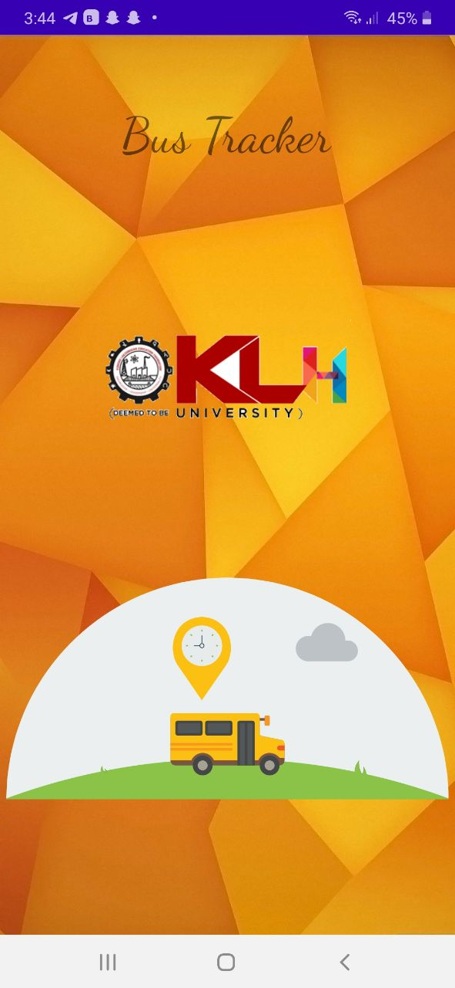
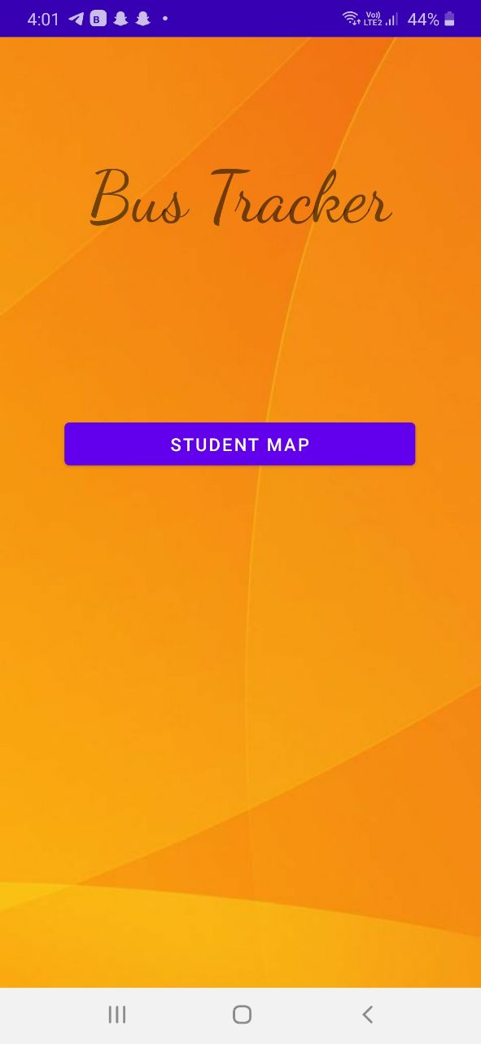
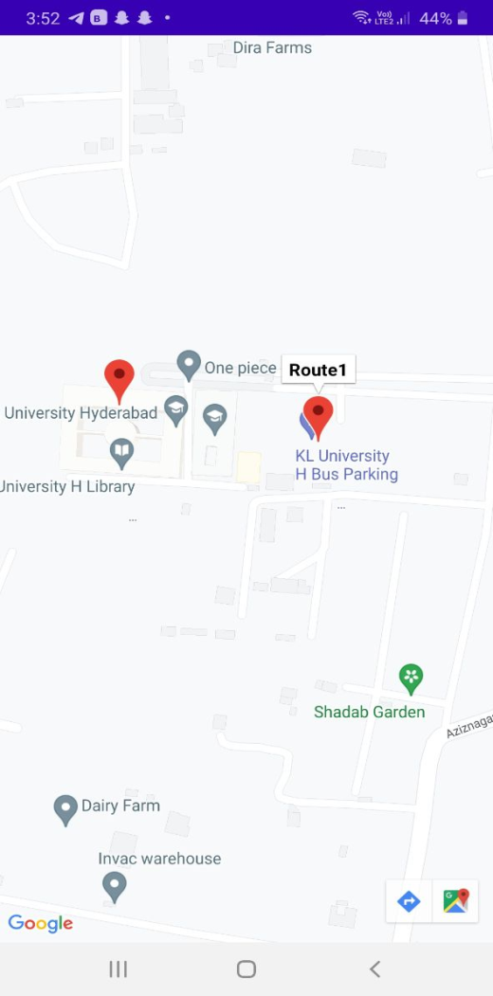
Implementation Images

Slide 19
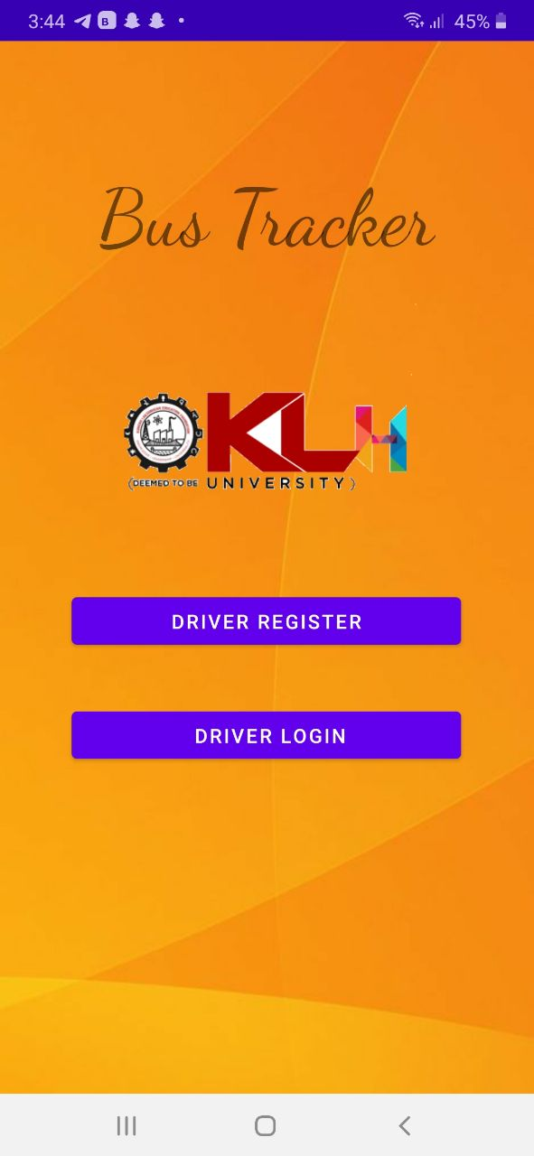
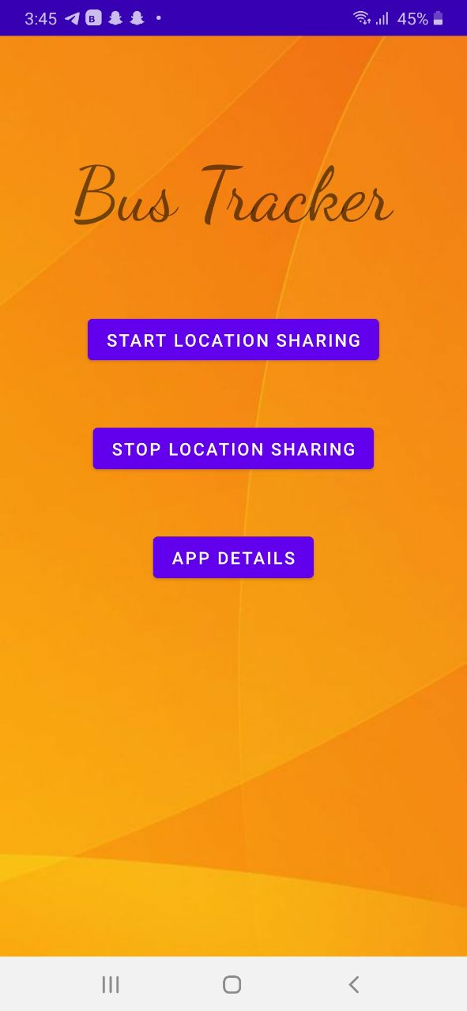
Implementation Images

Slide 20
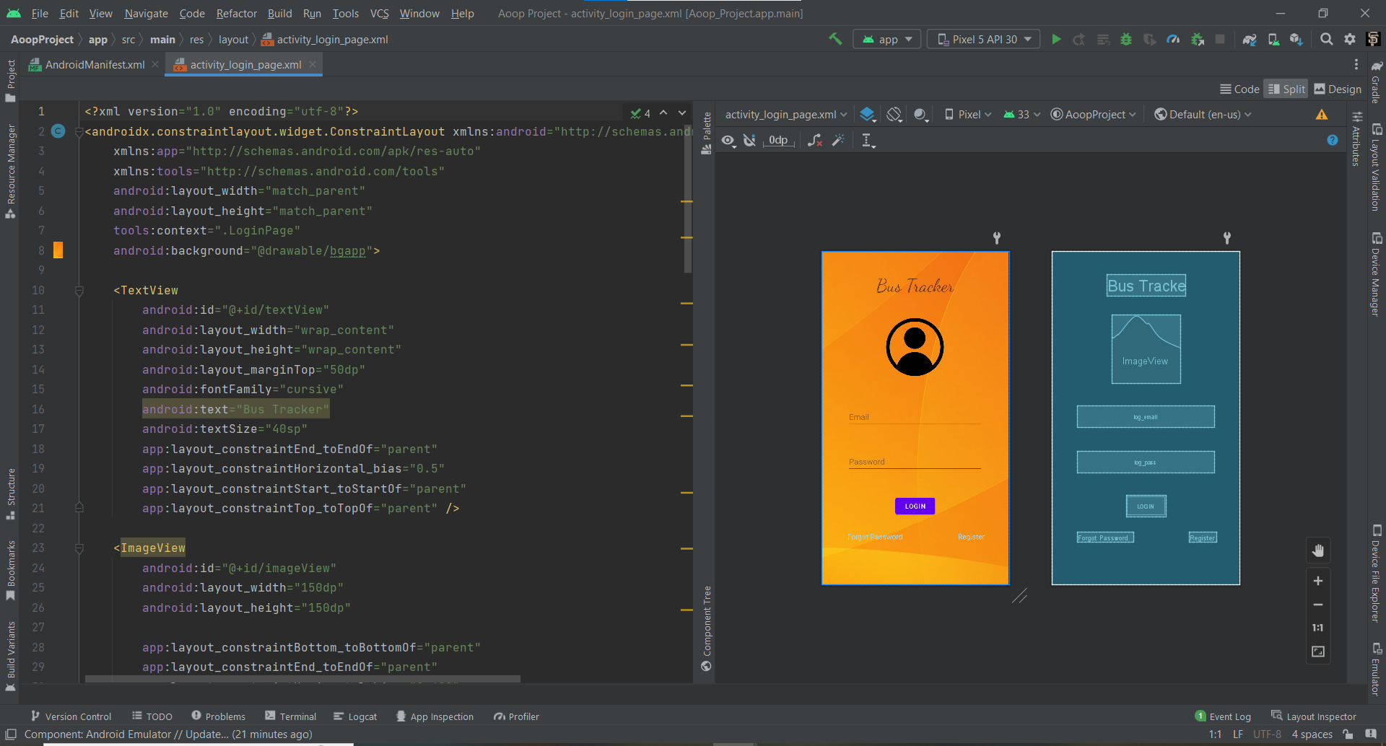
Implementation Images

Slide 21
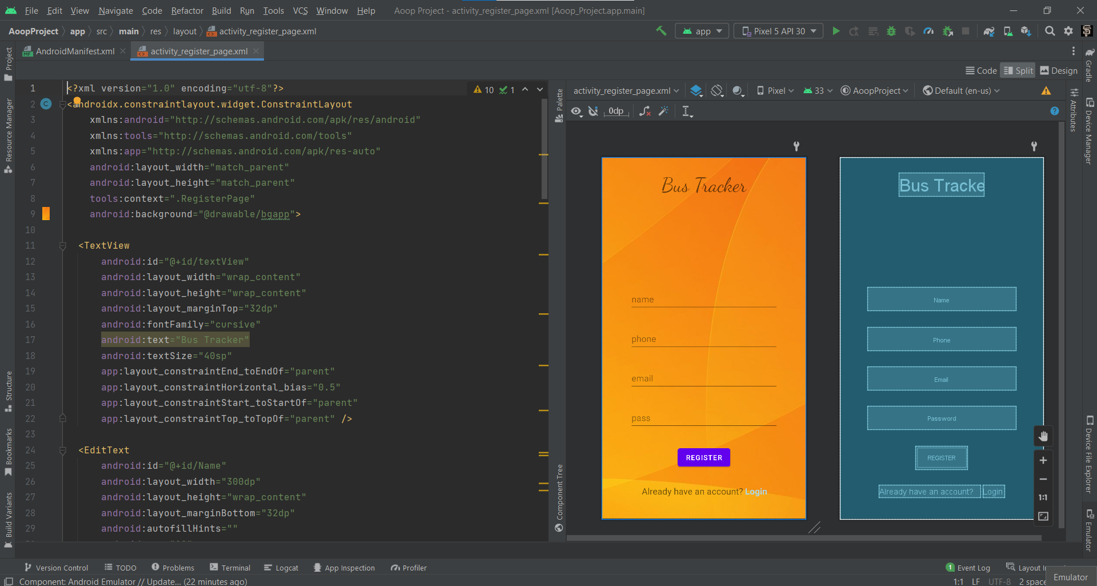
Implementation Images

Slide 22
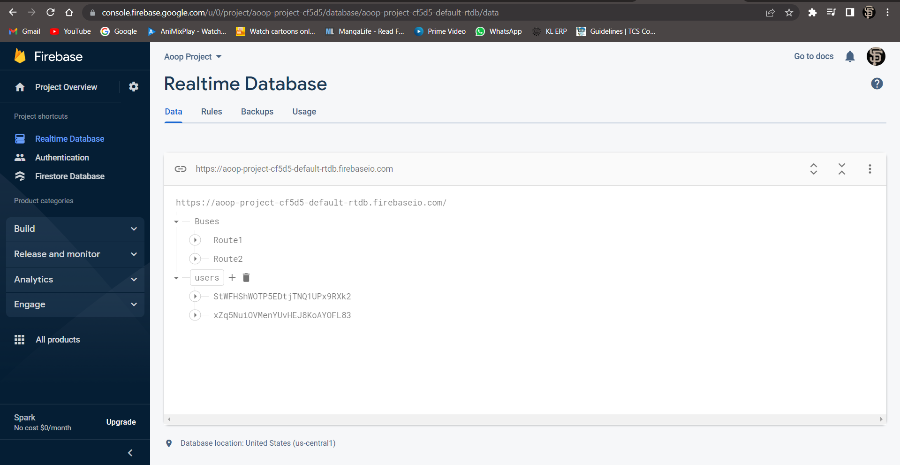
Database Images

Slide 23


